Slide 1
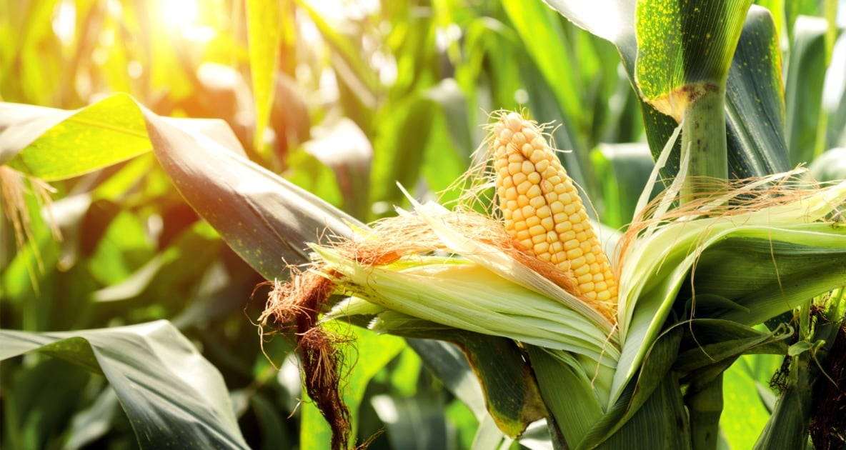
Corn Leaf Disease Classification
A Convolutional Neural Network Analysis
By Clement Chen

Slide 2
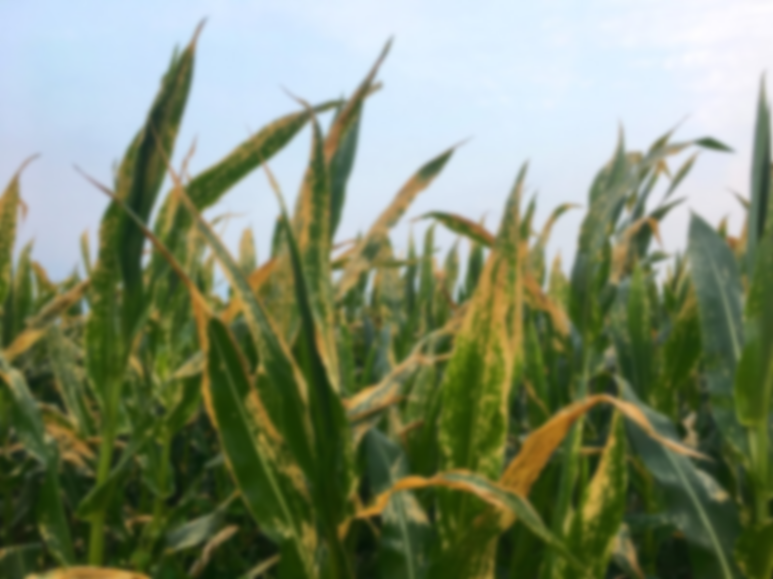
The Problem:
Corn leaf diseases are diverse and prevalent causing millions in losses each year
Current way of identifying corn leaf disease is through slow laboratory testing
Human identification can be prone to errors
Can we develop a machine learning algorithm that can predict corn leaf disease?

Slide 3
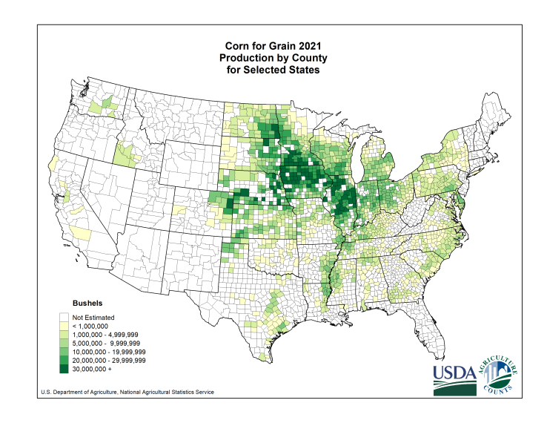




Who Would Find This Analysis Useful?
• Farmers
• Food and Beverage Corporations
• Energy Industry

Slide 4
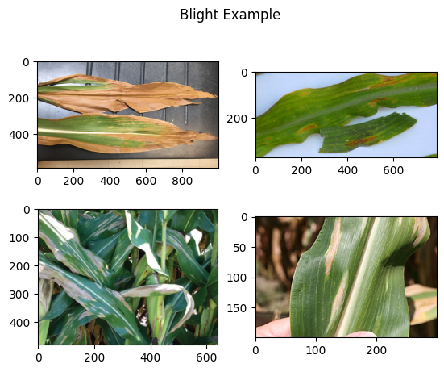
Corn Leaf Dataset
• RGB JPEG images of various dimensions
• Source: PlantDoc and PlantVillage datasets
• 4 classes: Blight, Common Rust, Gray Leaf Spot, and Healthy with 1146,1306, 574, and 1162 instances respectively
• The images have varying backgrounds, lightning, and can part of a leaf or contain multiple plants. Some images are partially occluded.

Slide 5
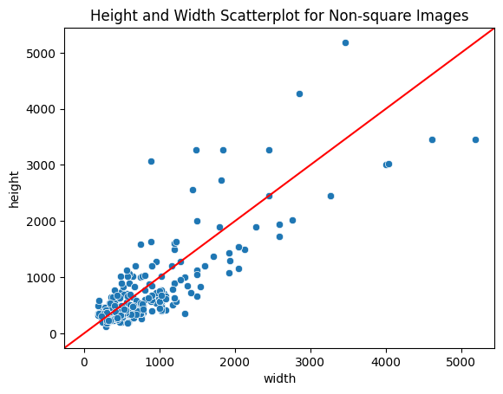
Data Wrangling and EDA
CNNs require input images be the same
92% of our data has dimensions of 256 x 256
The other 8% fall on this scatter plot.
There are several options to resize this data:
• Cropping
• Stretching
• Zero-padding

Slide 6
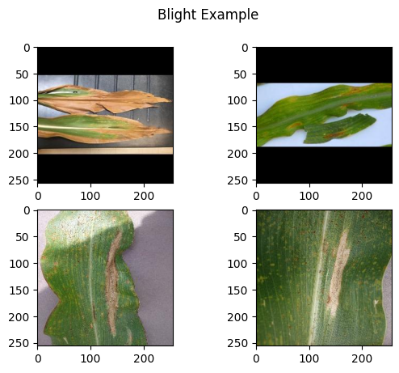
Data Wrangling and EDA
Cropping
• Lost pixels
• Wide variety of image dimensions
Stretching
• Feature distortion due to changed aspect ratio
• Granularity loss
Zero-Padding
• Maintains aspect ratio
• Pad with ‘zero’ pixels

Slide 7
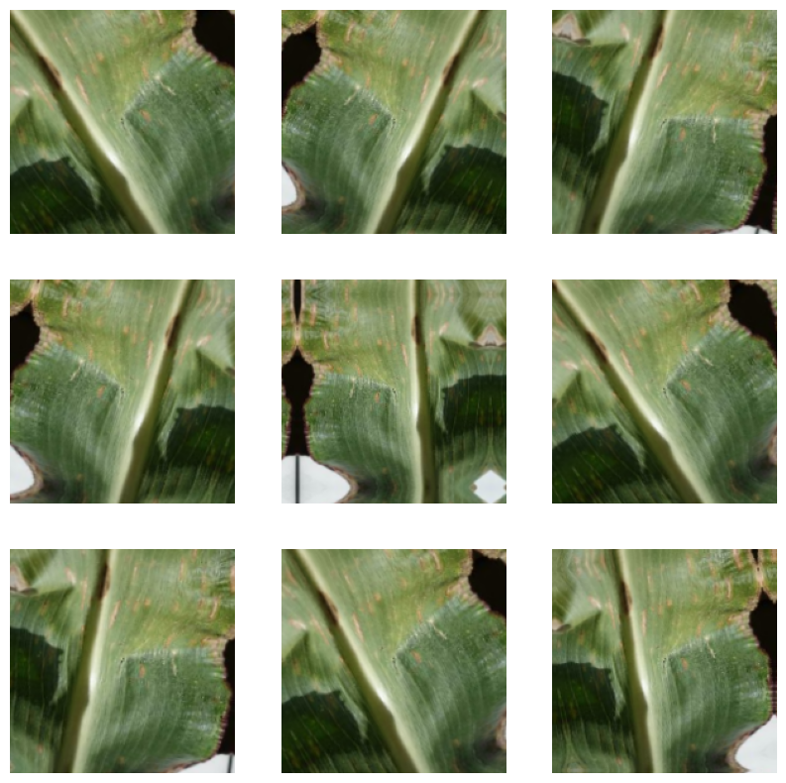
Preprocessing and Modeling
Data Augmentation
• Random horizontal flip
• Image rotation +/- 10%
• Zoom in or out +/- 20%
Data Augmentation provides a way of generating more data for the model to train on to reduce overfitting. One image can generate many other slightly different images of the same class.

Slide 8
Preprocessing and Modeling
Base CNN
Conv2D(f=32,actv=relu)
Model 1
Original Data
Max Pooling(size=2)
Conv2D(f=64,actv=relu)
Data Augmentation
Max Pooling(size=2)
Flatten
Conv2D(f=128,actv=relu)
Output
Class
Inputs
Dense(units=4,actv=softmax)
Max Pooling(size=2)
Pixel Rescaling
Conv2D(f=256,actv=relu)
Model 2
Zero-Pad Data
Max Pooling(size=2)
Conv2D(f=256,actv=relu)
Input Data
Preprocessing
Convolutional Layers
Dense Layers
Output

Slide 9
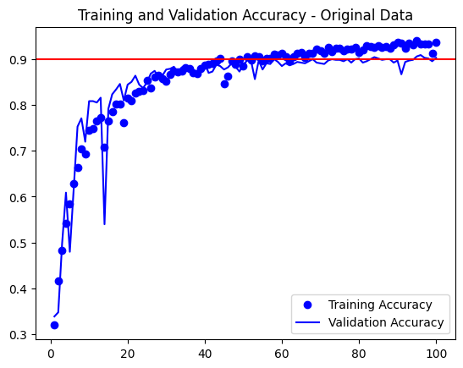
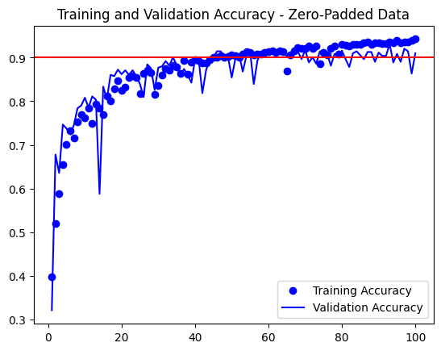
Preprocessing and Modeling
Original data reaches a validation accuracy of ~ 90% before starting to overfit around epoch 65.
Zero-Padded data reaches a validation accuracy of ~93% before starting to overfit around epoch 80.

Slide 10
Transfer Learning CNN
Conv2D(f=64,actv=relu)
Hyperparameter Tuning
Conv2D(f=64,actv=relu)
Max Pooling(size=2)
Units: (128,512),
step=32
Rate: (0.1, 0.5),
step=0.2
Conv2D(f=128,actv=relu)
Flatten
Data Augmentation
Conv2D(f=128,actv=relu)
Zero-Pad Data
Max Pooling(size=2)
Dense(units=256)
Conv2D(f=256,actv=relu)
Dropout(rate=0.1)
Conv2D(f=256,actv=relu)
Pixel Rescaling
Conv2D(f=256,actv=relu)
Inputs
Dense(units=4,
actv=softmax)
Output
Class
Max Pooling(size=2)
Conv2D(f=512,actv=relu)
Conv2D(f=512,actv=relu)
Conv2D(f=512,actv=relu)
Max Pooling(size=2)
Input Data
Preprocessing
Convolutional Layers
Dense Layers
Output
(Frozen VGG16 Weights)

